Slide 1
home service provider

Slide 2
Team
Kamani Meet
Kashipara Rushit
Dhankecha Harsh

Slide 3
Work done by over Team Member
Meet
Rushit
Harsh
UI-Design
Backend
PPT designing
Wire frame
Documation
Front design application
PPT designing
SRS document
Diagram
Backnd (DataBase
connection)
Diagram

Slide 4
Need of Application
Nowadays it is difficult for people to find any services in
emergency at any time and place.
So We are coming with new Home services provider app which
provides services like Plumbing, Electrical, Cleaning etc...
We provides information about all workers nearest to your
location.
Our app will help rural areas people to get service easily.
Our app will also help people to saving their time because
people can directly contact to workers.

Slide 5
This app is build with several features. Some of them are as follows:
1. This app provides details of all the service providers which are required in daily life like painter, plumbers, cleaning, electricians, etc.
2. This app is beneficial for both the persons requiring service as well as the service providers.
3. For persons requiring service in a way that they can get details of the service providers around their locality as well as around any region / area. Secondly, it saves their time as they get services sitting at home itself.
4. For the service providers in a sense that they get jobs/ orders sitting at homes.
5. This app filters out the results of these service providers according to the region / area.
6. It gives all the details of the persons providing services like name, age, address, mobile no., job experience, previous records, no. of complaints, etc.

Slide 6
Database specification
The customer’s web browser shall never display a customer’s password. It shall always be echoed with special characters representing typed characters.
The customer’s web browser shall never display a customer’s credit card number after retrieving from the database. It shall always be shown with just the last 4 digits of the credit card number.
The system’s back-end servers shall never display a customer’s password. The customer’s password may be reset but never shown.
The system’s back-end servers shall only be accessible to authenticated administrators.

Slide 7
Technology
software specification
user
specification
Ram & Rom specification
Language : java
IDE : android studio
login
Ragister
view the service
select the service and also book the service
Edit profile
contact service
logout
Mobile version : android 5.0
Ram:4 gb or above
storage:32gb or above

Slide 8
limitation
only login at customer side .
Limited area are covered.
Limited worker available.
24 houre are not use.

Slide 9
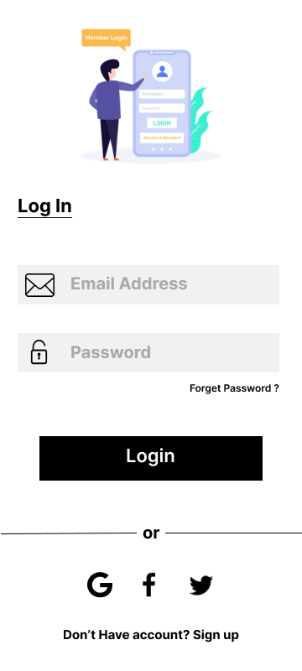
Login page
Login Email Through
Enter Password
Forget password
Login Button
Google , facebook ,twitter through login

Slide 10
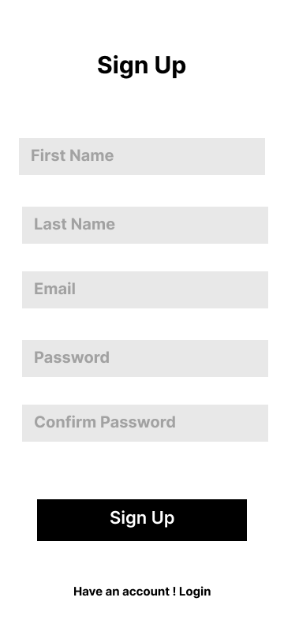
sing ip
Enter first Name
Enter Last Name
Enter Email
Password Enter
confirm Password
Sign up button

Slide 11

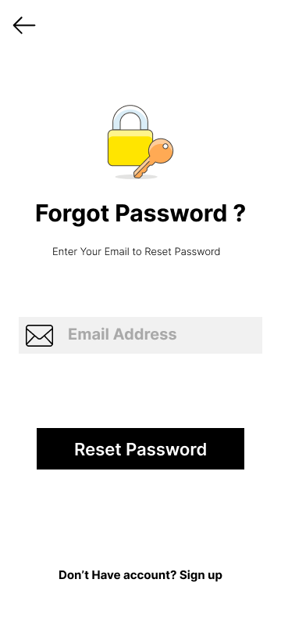
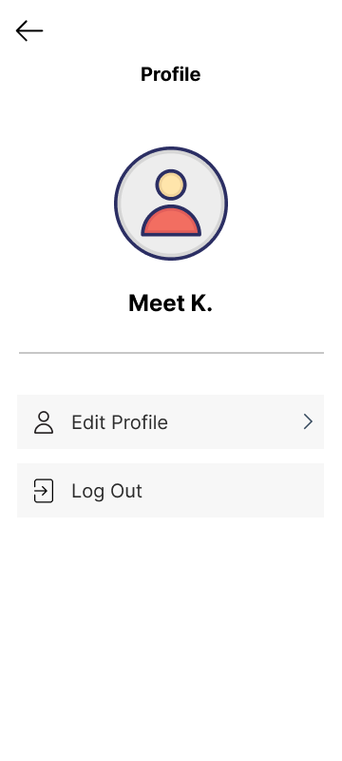
limitation spla
Email id
Reset Password

Slide 12
limitation spla
Back to next Page
Edit Profile
Log out

Slide 13
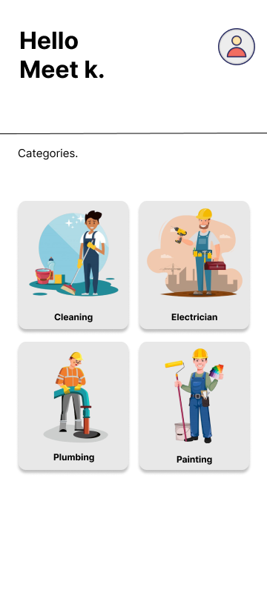
limitation spla
profile button
All 4 categories

Slide 14
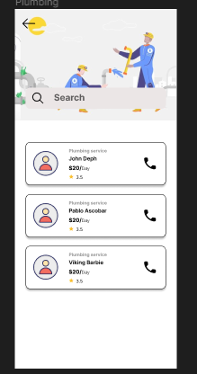
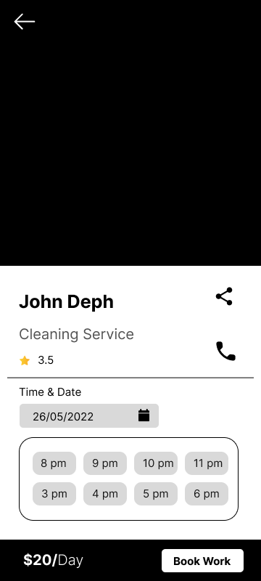
limitation spla
search box
worker detail

Slide 15
limitation spla
Back to next Page
share & contect as
Time & Date

Slide 16
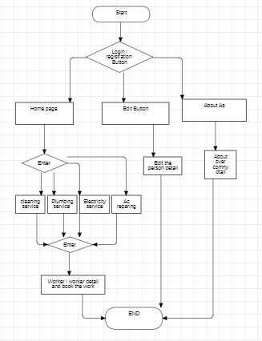
Flow Chart:

Slide 17
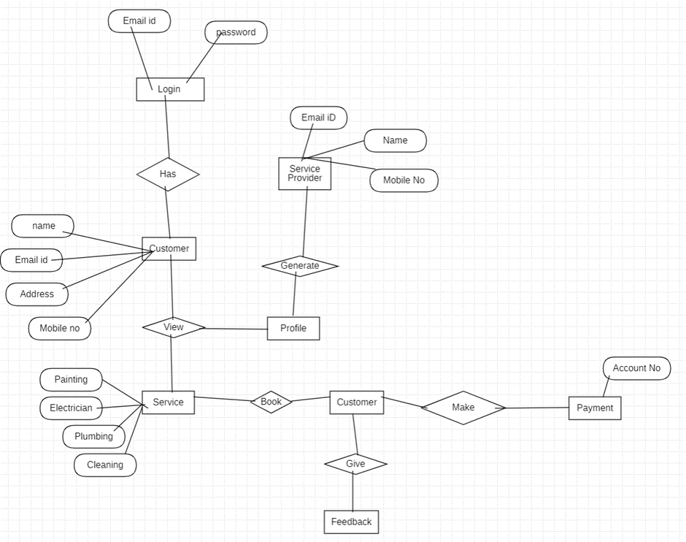
ER Chart Diagram

Slide 18
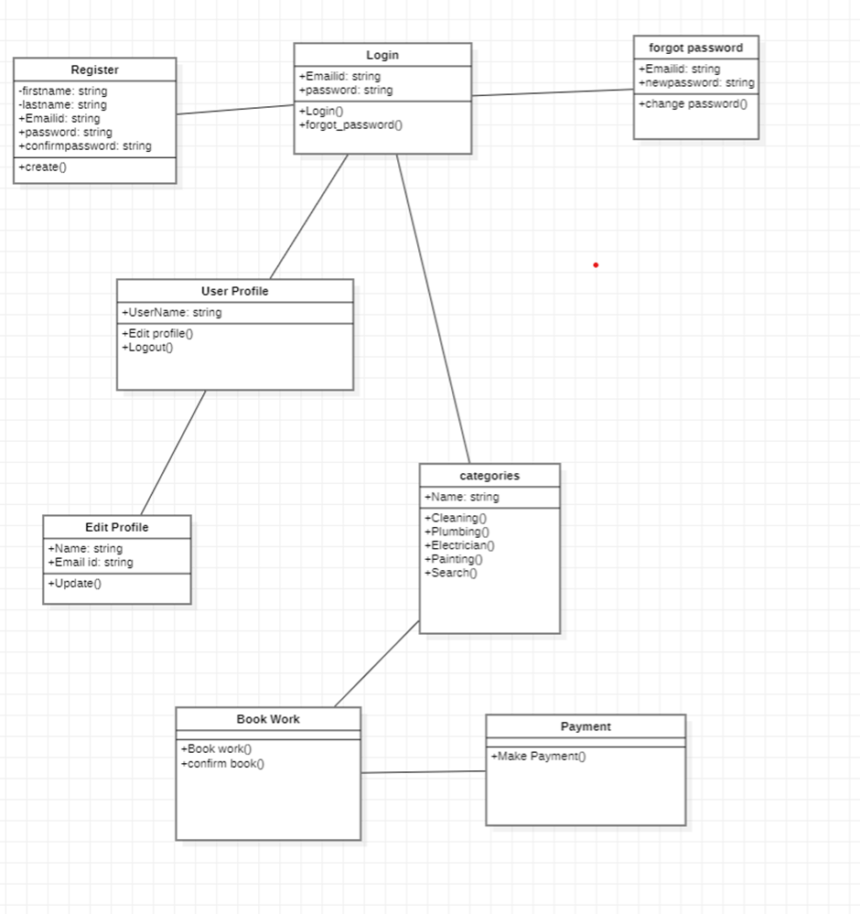
Class Diagram

Slide 19
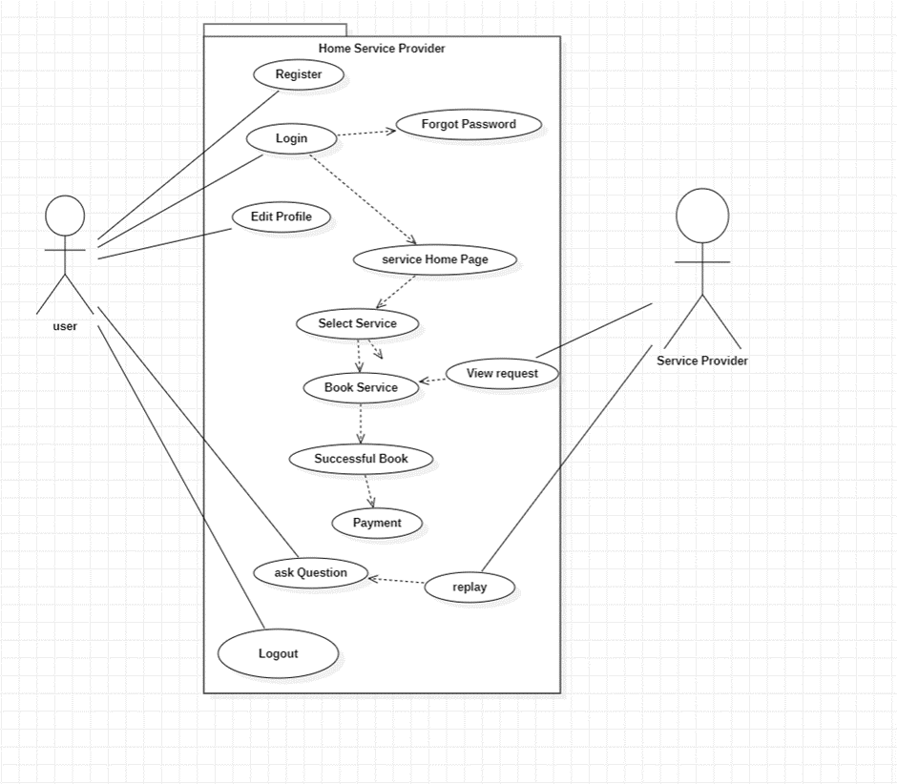
Use Case Diagram

Slide 20
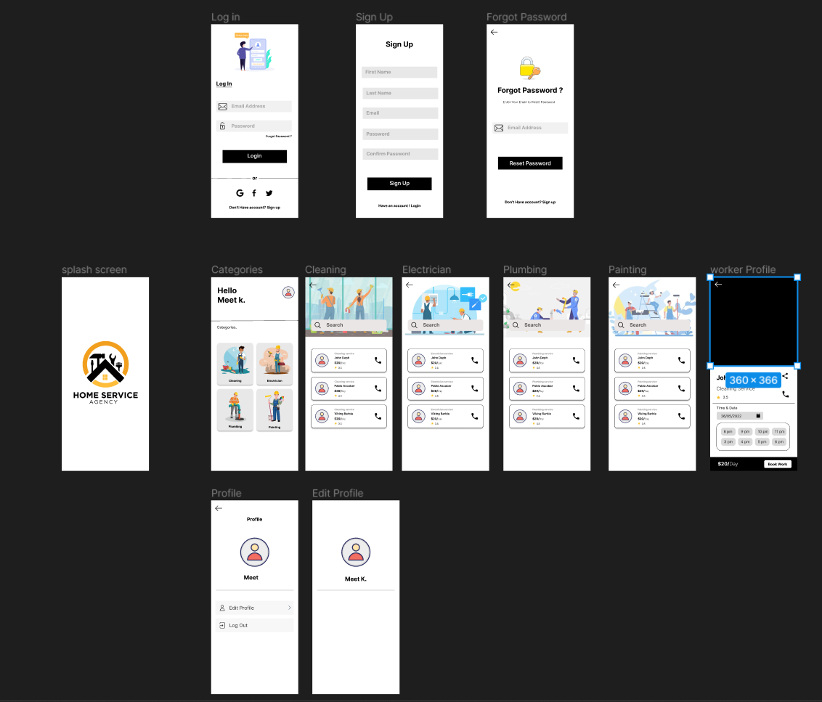
wire frame:

Slide 21
Thank You

